Slide 1
Arrays, .map(), and Rendering Lists

Slide 2
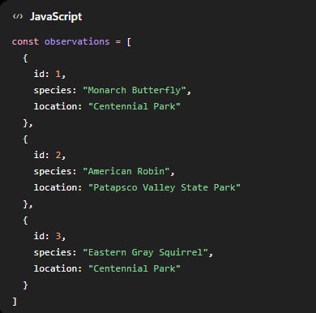
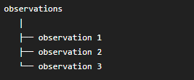
Javascript array
Inside App.jsx, create an array called observations:
An array is just a collection:
Each item is an object.
observation 1
object

Slide 3
Access one item
You can access the first item with index 0:
  observation[0]
So
  observation[0].species
gives:
  Monarch Butterfly
Change index to access other items. For example,
  observations[1].species
gives:
  American Robin

Slide 4
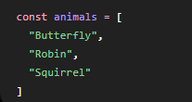



Why .map() is useful
Suppose we have an array animals:
We can go through each item using
For example:
The result becomes:
So .map() basically means:
  Go through every item in this array and create something new from each one.

Slide 5
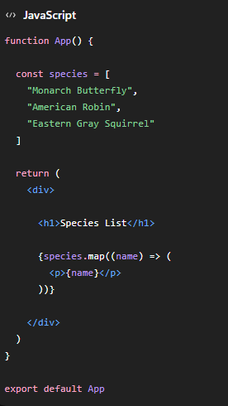
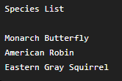
Render a list in React
In App.jsx code this:
React will display
React create one <p> for each item.

Slide 6
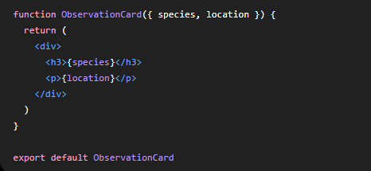
Apply array and .map to ObservationCard
In lesson 2, we created ObservationCard.jsx
Then in App.jsx, write code (see attached App_lesson4_1.jsx)
Now React creates three cards automatically.

Slide 7
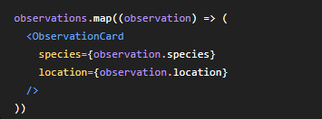
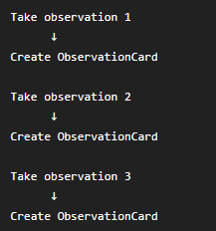
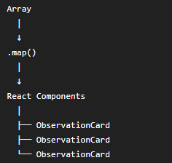
Understand what .map() is doing
This: means:
Conceptually:

Slide 8

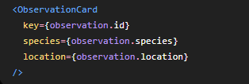

Add a key prop to ObservationCard
So we change: to:
Now React can identify each card.
Why key matters?
  Imagine React currently has
  Then observation 2 changes.
  Because each item has a unique key, React knows exactly which component changed.

Slide 9
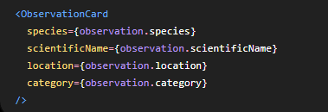

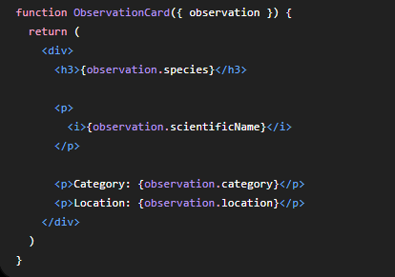
A cleaner way: pass the whole object
When an object has many fields, instead of passing every property separately:
we could pass the whole object:
Then change ObservationCard_lesson4_2.jsx:
See attached App_lesson4_2.jsx.

Slide 10


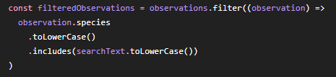
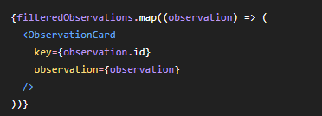
Add filtering
Suppose the user types
We only want matching observations.
Start with
Then create
Then render
.filter( ) means:
Keep only the items that match a condition. Here it matches searchText value from input box

Slide 11
Complete searchable version
See attached App_lesson4_3.jsx and ObservationCard_lesson4_3.jsx

Slide 12
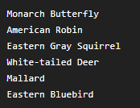
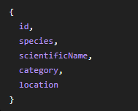
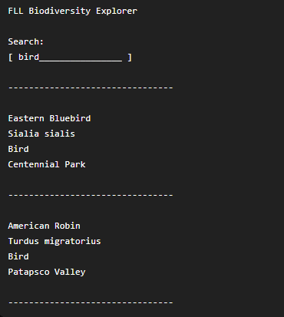
Challenge
Build a small dataset with at least six observations. For example,
For each observation store:
Then make you app display:
Your app should us both .filter( ) and .map( )

